Slide 1
AirDraw
Final Demo
ECE532 Group 1

Slide 2
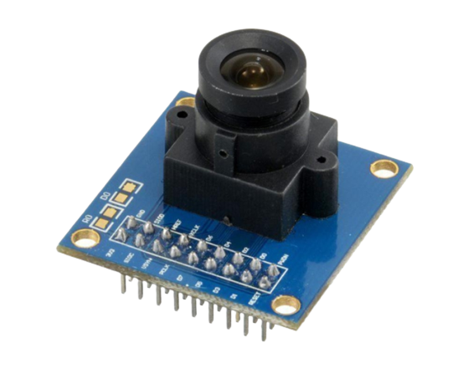
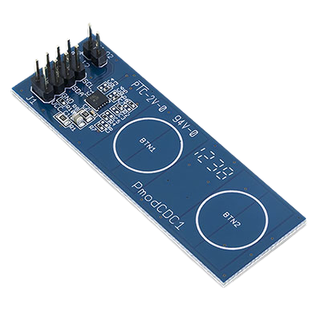
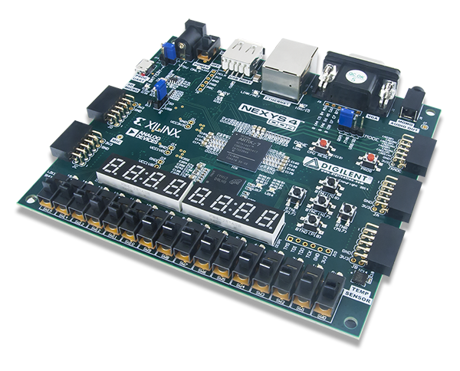
Recall: Project Overview - AirDraw

Slide 3
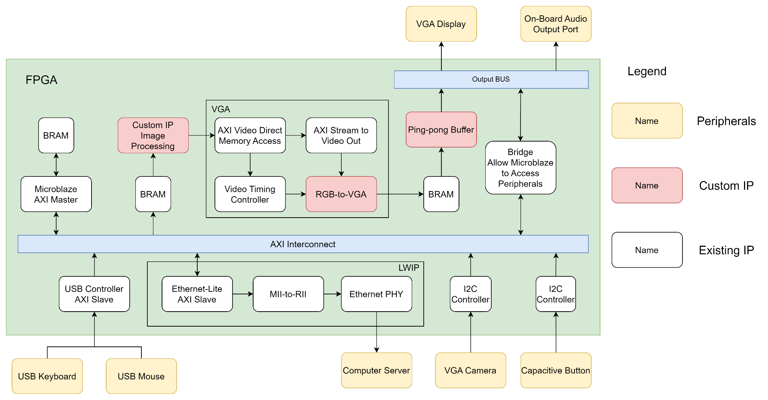
Proposed System
Since we are not displaying real-time image on screen, a ping-pong buffer is not necessary
Not necessary
Do not have time to implement TCP
Can only fit one USB port peripheral
Notes:
Here is our proposed design from before, the system has a hierarchical bus topology in which the AXI interconnect is the main bus for the Microblaze to communicate with other blocks, and the output bus is solely used for VGA and audio output. However, We decide to make a few changes to the architecture.

Slide 4
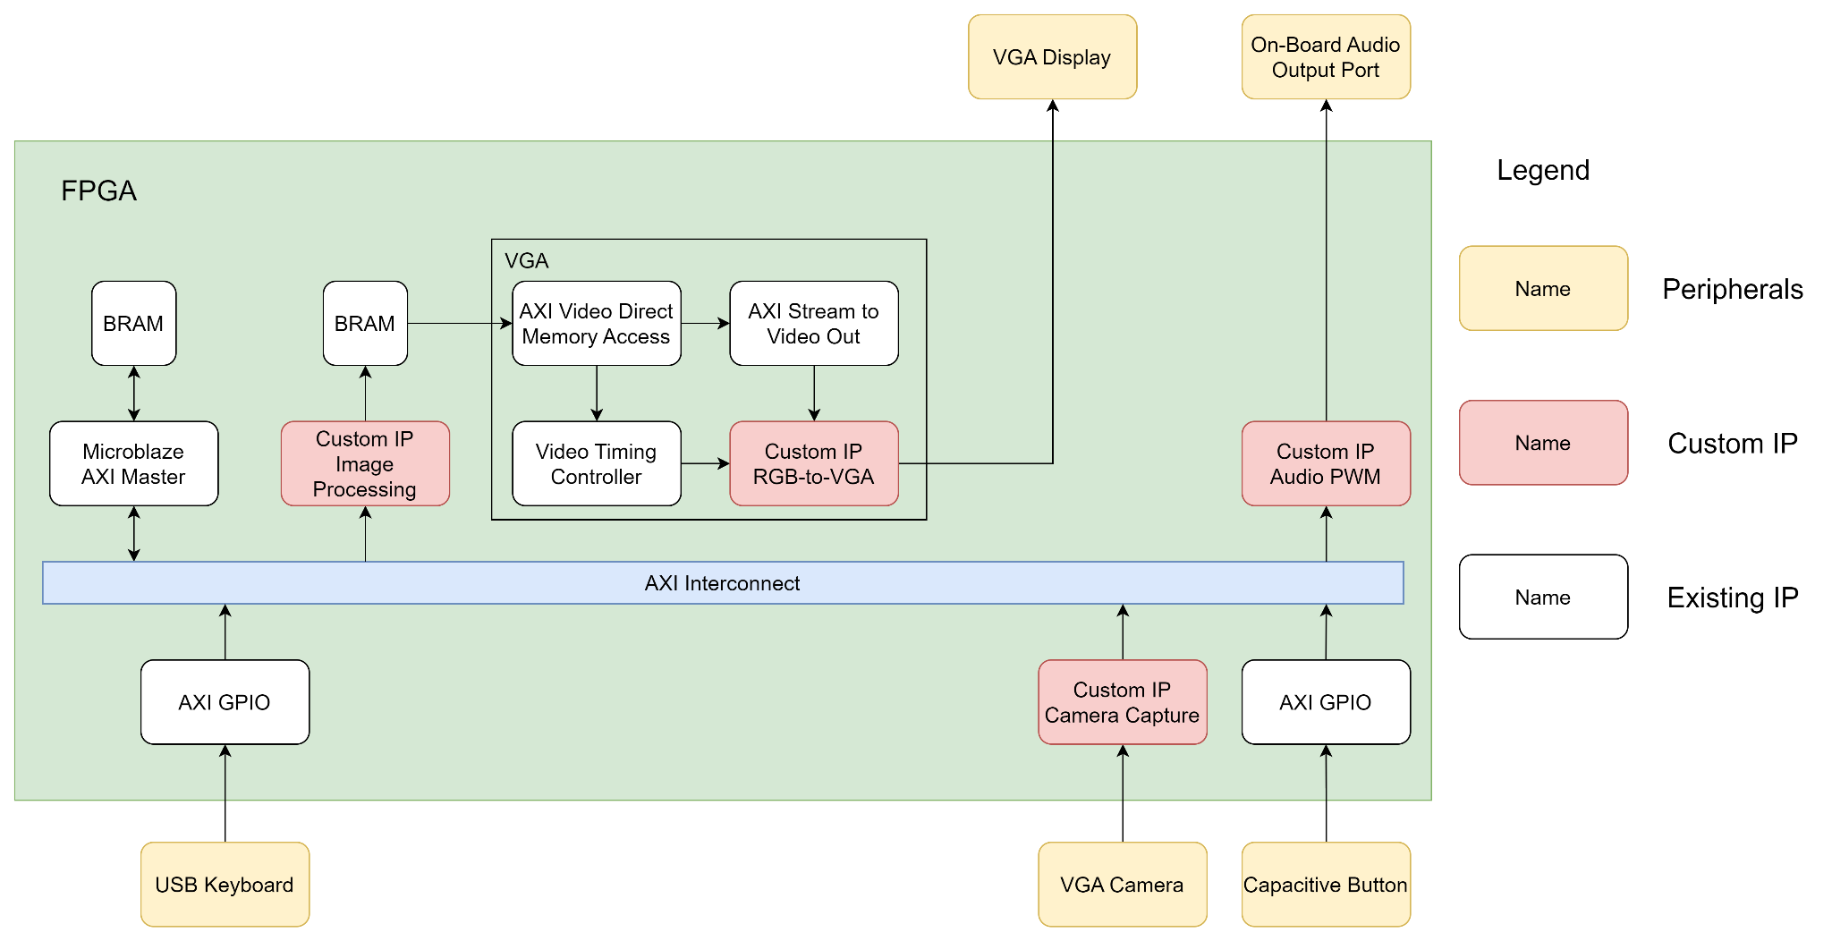
Current System
Notes:
Finally we have decided to create a custom IP for the the camera capturing functionality. We implemented the whole protocol in verilog and the output of the camera capture IP will be fed into the image processing unit directly.

Slide 5
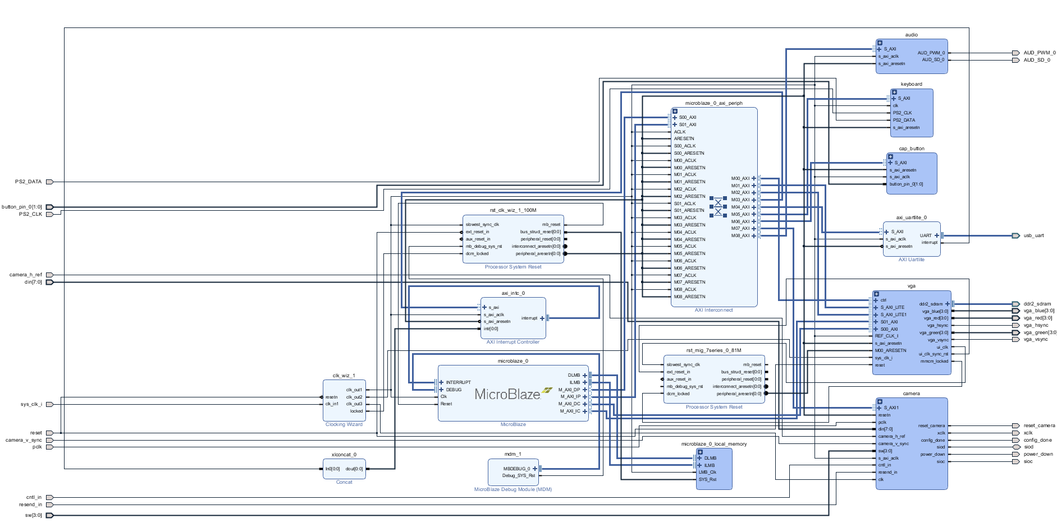
Current System
Notes:
Here I present our system overview. The design is in composite of several functional units including the VGA stream out module in red, the camera stream in block in green, the audio, keyboard and a capacitive button controllers in green and finally a central MB and its interconnects in purple that handles the UI as we will demonstrate.
There exists two clocks to our systems one drives the MB and one native from the cmos camera that drives our authentic camera module. We formulated our camera module such that it will have synchronous behaviour when connected to the MB clock domain using AXI interface. Now, haley and I will be presenting the details of the subblocks.

Slide 6
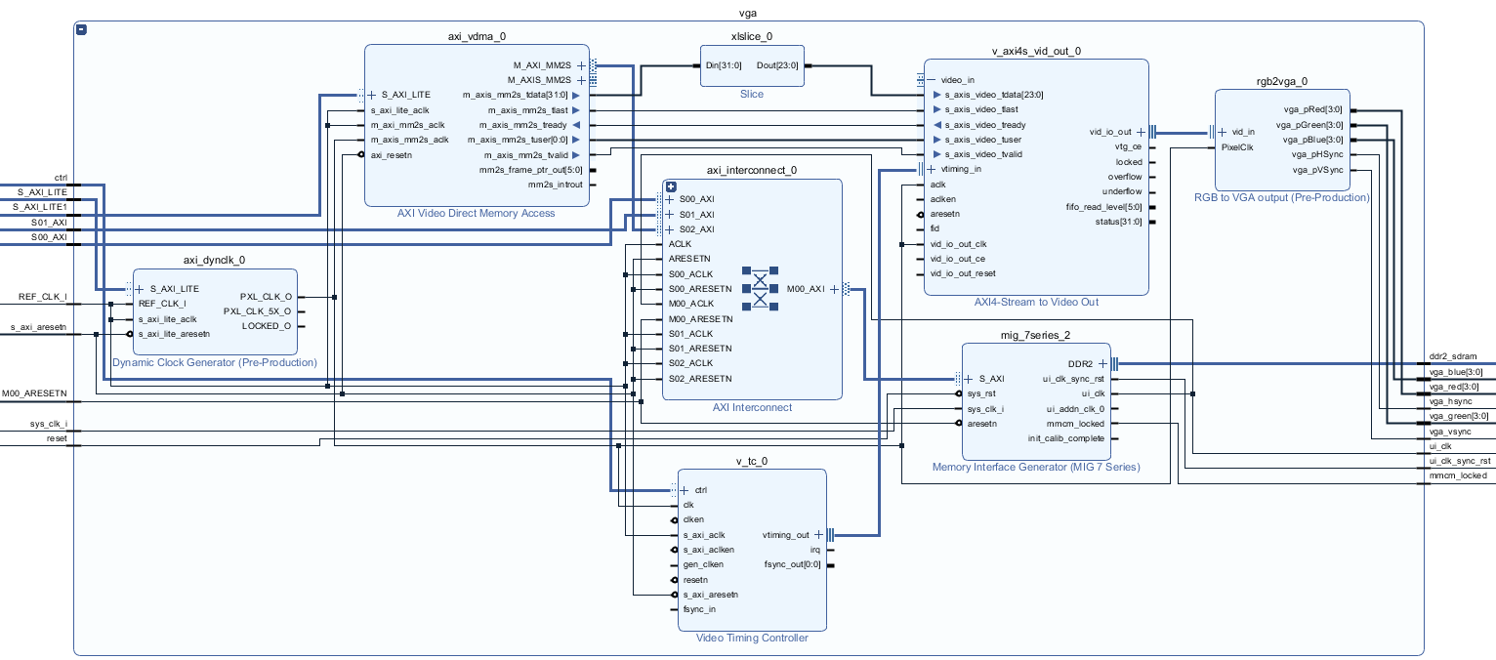
VGA
Notes:
This shows the internal of our VGA subblock which receives data from the MB using an AXI VDMA and push the processed RGB data into a buffer called AXI-Stream to Video Out. The output of the buffer will be converted into actual pixel through a RGB to VGA block in the right top corner. The dynamic clock generator and the video timing controller are used to produce a clock signal to the video buffer.

Slide 7
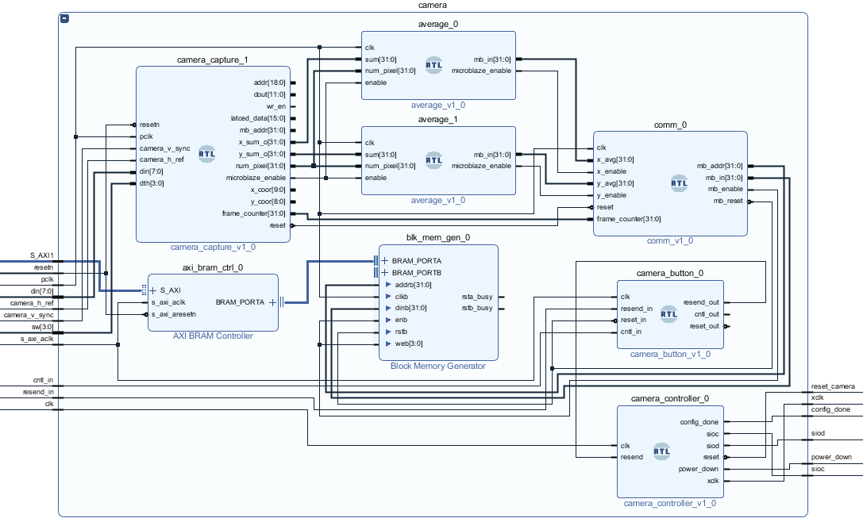
Camera
Pclk
Notes:
the camera stream-in block maps several custom blocks we created for our design and operate at the native pclock domain shown in the red arrow. In the red region, first, the authentic camera_capture block will receive the input pixel data and turns the color coding from RGB888 to grayscale
it will track the x and y coordinates and count of active pixels if the luminance of the pixel is above a certain threshold, which is adjustable by the on-fpga switches.
When finished processing an entire frame, the module will send the x and y and the active pixel count to two mean value calculators we created ourselves. After the mean calculations are finished, the results will be popped to a communication module and it will store the data using a block RAM generator.
The green region is an pre-existing module from online resource we made no modification that serves to change the camera register files since some of the default settings of the camera is undesirable. Pushing the on-fpga resetting button will set the camera to our preferred profile.This serves to be the initialization process.

Slide 8
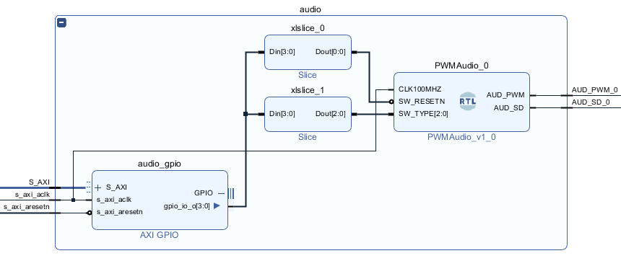
Audio
Notes:
PWM:
We wrapped a custom VHDL module to implement the SPWM (sinusoidal pulse width modulation), and feed the regenerated digital pulses with varying widths to the audio port to generate analog audio signals. The sampling rate can be modified to output audio tones at different frequencies. We configured a few audio pieces in the module to build a multiplexer, taking the selector signals from the microblaze through GPIO, to play different sounds.

Slide 9
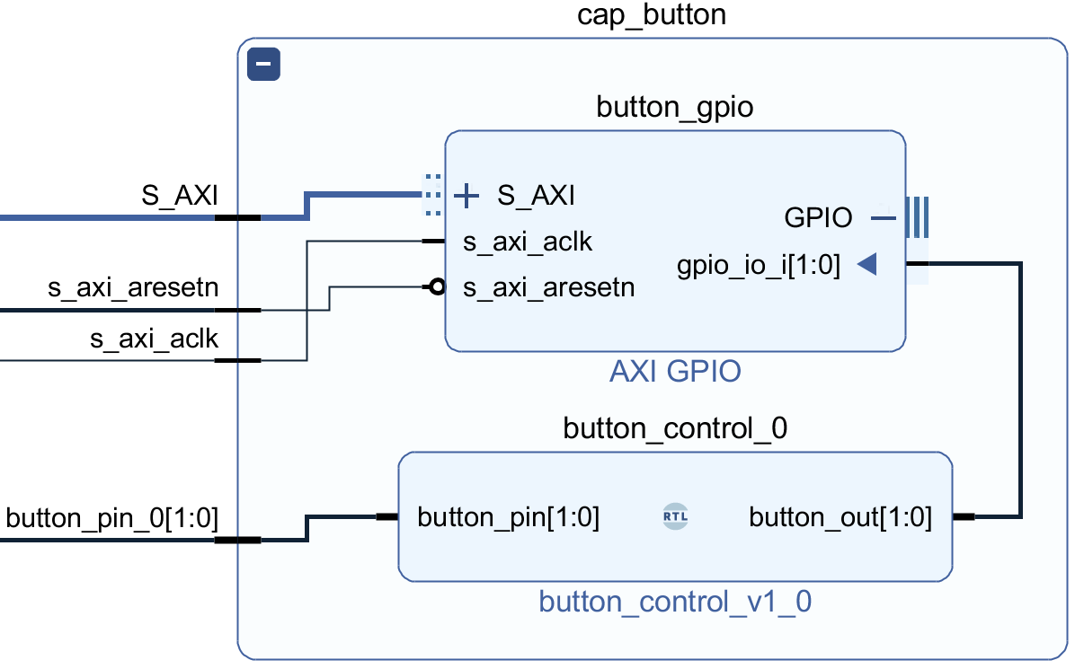
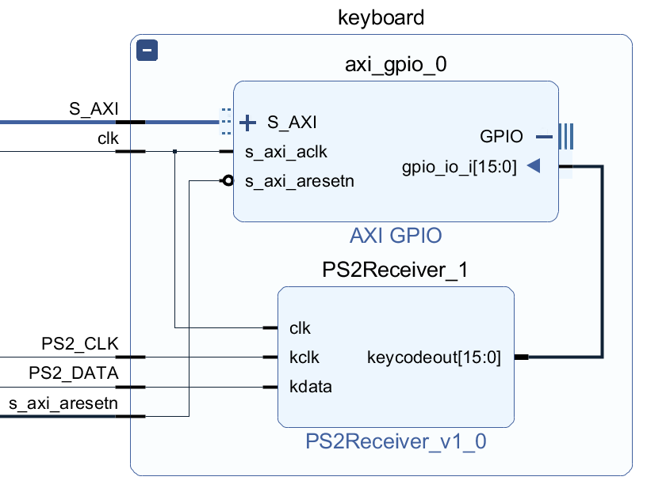
Capacitive Button & Keyboard
Notes:
Another 2 peripherals are the capacitive button and the keyboard. If putting the finger on the button, the signal will be high and vice versa. We study the behaviours of the keyboard by observing the changes of the scan codes at the moments of pressing and releasing. The two red boxes again are the modules written by the group and both the 2-bit button data and 16-bit keycode data are accessible by the microblaze through the GPIO.

Slide 10






SDK Design Process
Preset Memories:
Menu Logos (40*40*4 B * 6)
Letters (25*25*4 B * 26)
Numbers (20*25*4 B * 10)
Video Direct Memory Access:
VGA Pixels (640*480*4 B)
User drawings (lines, texts):
Drawing Pixels (640*480*4 B)
Key Functions:
Draw / Erase
Line Weight / Colour
Text
Clear
Notes:
Preset Memories to store the image of menu logos, letters, numbers.
There is a frame buffer storing the RGB data displayed on the VGA where there is direct memory access between the memory buffer and AXI-stream video target peripherals.
There is another memory array whose size the same as the frame buffer, which stores only the drawing data, excluding some GUI components such as the cursors of the pen and the eraser.
We divide our proposed functions into 6 modes, and detect the rising edge of the button to switch modes. In draw/erase mode, the camera detects the position of flashlight and display it onto the VGA. The button also acts as an enable signal when users can input their drawing traces onto the display. In line/weight and colour switch mode, users can switch the width of lines and the colour of the pen and text. We have a custom colour code function where the user type the hex code of a colour to customize it through keyboard input. In text mode, user can use the flashlight to select the starting position of the text and then type. In Clear mode, the canvas will reset to blank to start a new drawing.

Slide 11
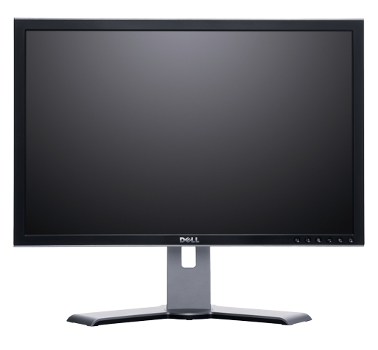

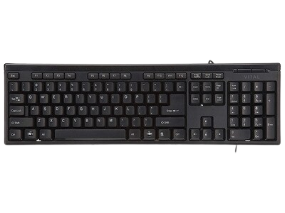
Design Process & Measure of Success
Notes:
Next I will be talking about our design process and measure of success. The design process can be broken down into two parts. The first part is to make the individual peripheral work as expected. We wrote specific testbenches to ensure each peripheral’s functionality. The second part is to integrate these peripherals in a specific order. We use the working VGA as the base system since VGA is the most important component in the entire system not only because it needs to displaying the drawing traces, but also acts as a visual debugging tool. Because Our project has a lot of visuals and does not really have any quantitative measure of success. So VGA can help us debug later on. Then we integrate the camera into the system since it is the major component of our project, and ensures that the camera can capture certain object and sends the correct location to the VGA. And then, the capacitive button is integrated as a enabling controller, and finally the keyboard and the audio that are minor and relatively independent components.

Slide 12
Project Management
Haley
Lei
Ourong
Charles
Integration
Image Processing
Notes:
Since our project uses a lot of different peripherals, we managed our team in the following ways. The team will be broken down into two groups at first, and each group will research and work on a different peripheral. Once both groups finish their parts, one person from each group will work together to integrate the peripheral that just achieved its own functional correctness. The rest of the group will then start looking at the new peripherals. Once the integration has finished, both designer will then get back to their original group to continuing working on the next peripheral. We kept this flow of designing among all four of us and we hold frequent meetings to ensure everyone is at the same pace.

Slide 13
What We’ve Learned
Technical
Using Vivado tool
Implementing different PMODs with hardware mapping
Creating AXI interfaces and generating custom IPs
Integration of different peripherals and synchronization
Management
Hardware system development is different from what we experienced in other undergrad courses (software)
Notes:
Finally, what we’ve learned. From this project, we learned a lot both from the technical side and the management side. On the technical side, we learned how to use the Vivado CAD tool in general, we learned how to implement different PMOD peripherals and maps them onto the FPGA through constraint files. We learned how to wrap custom IP blocks with AXI interfaces so that they can communicate with other blocks. And we learned how to integrate different peripherals while maintaining the correct synchronization of timing among all of the peripherals. On the management side, we realized that hardware system development is actually quite different from the software development that we used to have in most of the undergrad courses. For example, version control was easy in software development but hard for us since there is no version control tools we could use, and we had to merge code manually. That’s what we’ve learned, and we can start the demo.

Slide 14
DEMO TIME

